Slide 1


An Advisor Neural Network framework using LSTM-based Informative Stock Analysis
Technical Test - Data Scientist
Melani Hariono

Slide 2








Introduction
Why Stock Market Forcasting?
This study proposes an LSTM-based framework that integrates multiple data sources and provides daily actionable advice.
Old Approach
Background
1
Technical Analysis Only – Banik et al. (2022)
Focus on Price & volume history with indicators only. This might be ignores external market drivers such as news and macro events.
Stock market is one of global economic pilars. Market > %100T in 2022
Fundamental Analysis Only – Ozbayoglu et al. (2020)
Focus on Company financial reports and balance sheets only. Too static, unable to capture short-term market fluctuations or sentiment shifts.
2
News or Financial Data Only – Huang et al. (2023)
Only focus on news or financial text. Overlooks technical signals and market dynamics, leading to incomplete forecasting.
High profit potential, but also highly volatile & risky
3
Integration of financial data, technical indicators, news sentiment, and seasonality.
What’s needed?
Handles the non-linear and non-stationary nature of the market.
Stock market forecasting is crucial to mitigate risks and support informed investment decisions
Generation of daily actionable investment advice instead of mere price forecasts.

Slide 3




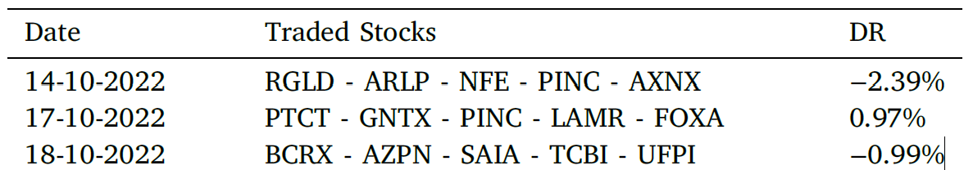
Proposed Framework & Contributions
Advisor Neural Network Framework using Long Short Term Memory (LSTM) based for Daily investment Advise. Successively, the advice unit provides next-day advice based on predicted information in conjunction with the proposed Heuristic Stocks Selection algorithm.
1
Input Data
Historical Stock Data
News Data
Technical Indicators
Seasonality Patterns
(1/11/2019 – 31/10/2022)
Historical financial data crawled from portals (e.g., Yahoo Finance, Google Finance), with key features summarized.
News data from EOD Historical Data: two features — number of articles and sentiment score (-1 to 1).
Commonly used for stock trend prediction as they summarize time-series behavior: AO, RSI, ATR, ADX, Aroon, and Daily Return
Date field of the crawled historical financial (e.g., Day of the Week, Day of the Month)
Predict daily returns
2
3
4
LSTM Forecasting
Advice Unit
Heuristic Stock Selection Algorithm
Selects stocks with highest predictability.
Builder Unit
Update Unit
Prediction Unit
Evaluated on 400+ NASDAQ stocks and 67 Cryptos (3 yrs)
Predicted the next day’s Daily Return
Build neural network
Refresh data
Forecast daily return
Result
5
Why Daily Return?
as a target
“We decided to focus on Daily Return (DR) instead of closing prices since DR provides more informative insights for investors, reduces the non-stationarity problem of price series, and is directly related to actual investment decisions.”
Notes:
Score metric di sini digunakan untuk menilai seberapa baik prediksi model LSTM dalam menangkap arah (positif/negatif) tren saham.
Nilainya positif jika arah prediksi benar dan negatif jika salah, dengan magnitude menyesuaikan besarnya kesalahan.
Jadi fungsinya adalah evaluasi performa prediksi untuk setiap saham, bukan sekadar error biasa.
#

Slide 4


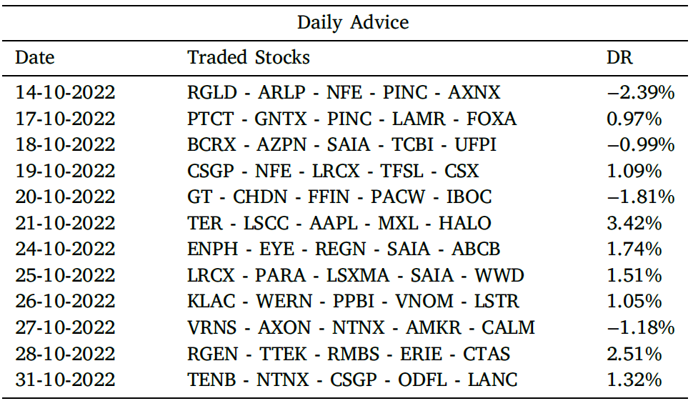



Advise Unit Explained
This unit relies on the output of the Forecasting layer to provide Daily Investment Advice by ranking the stocks according to a novel index.
2
Forecasting
Unit
Generate Output
Evaluation Metrics
Accuracy Arah Return
LSTM Forecasting Result
Generate buy/sell recommendations for selected stocks based on daily return predictions to guide investment decisions.
The Forecasting Unit generates daily price or return predictions for each stock.
Stock Selection
Result
Advise Production
Input Data
Higher 5 Top K
Consist of :
Select Top K stocks daily based on predicted returns for the investment strategy.
Date
Ticker
Predicted daily return.
Evaluation Metrics
Economic Gain
Accuracy cumulative return
Economic Gain
Stock : 64,62%
Stock : 41,21%
Crypto : 59,78%
Crypto : 39,38%

Slide 5

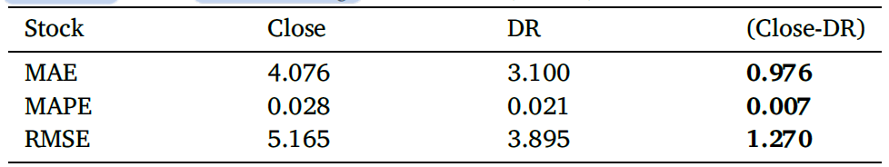
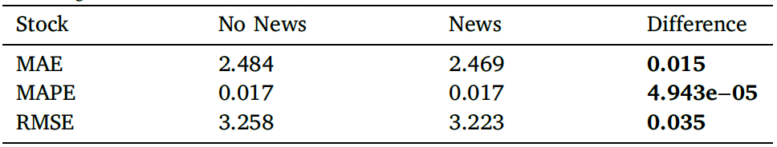
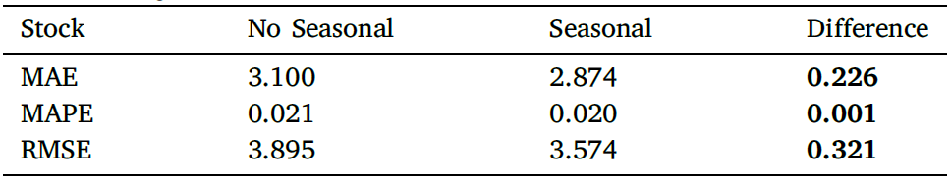
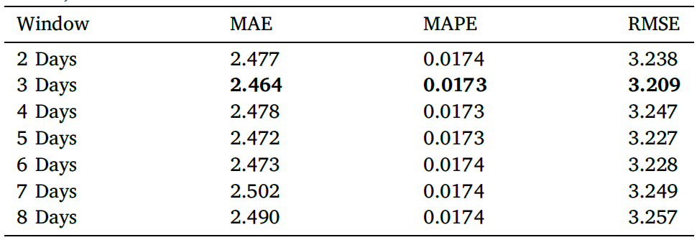
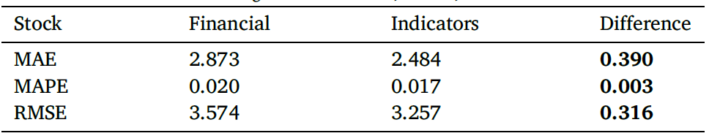
Result
Comparisons were made between the Closing Price and Daily Return predictions for 70 days on test data.
Tabel 7
Tabel 10
Daily Return is more accurately predicted then Closing Price. Therefore, Daily Return was chosen as the prediction target.
The final analysis added news data, which was shown to provide a significant improvement in prediction performance (Table 10).
Tabel 8
Hyperparameter Tuning
Tabel 11
Additional experiments showed that seasonal factors affect Daily Returns. The addition of these four categorical features improved model performance.
Tabel 9
The results (Table 11) show that the length of the time window significantly affects prediction performance. A 3-day time window yielded the best results compared to other measurements, consistent with previous research findings.
The next evaluation replaced financial features with technical indicators, and the results were better for all metrics (Table 9)

Slide 6
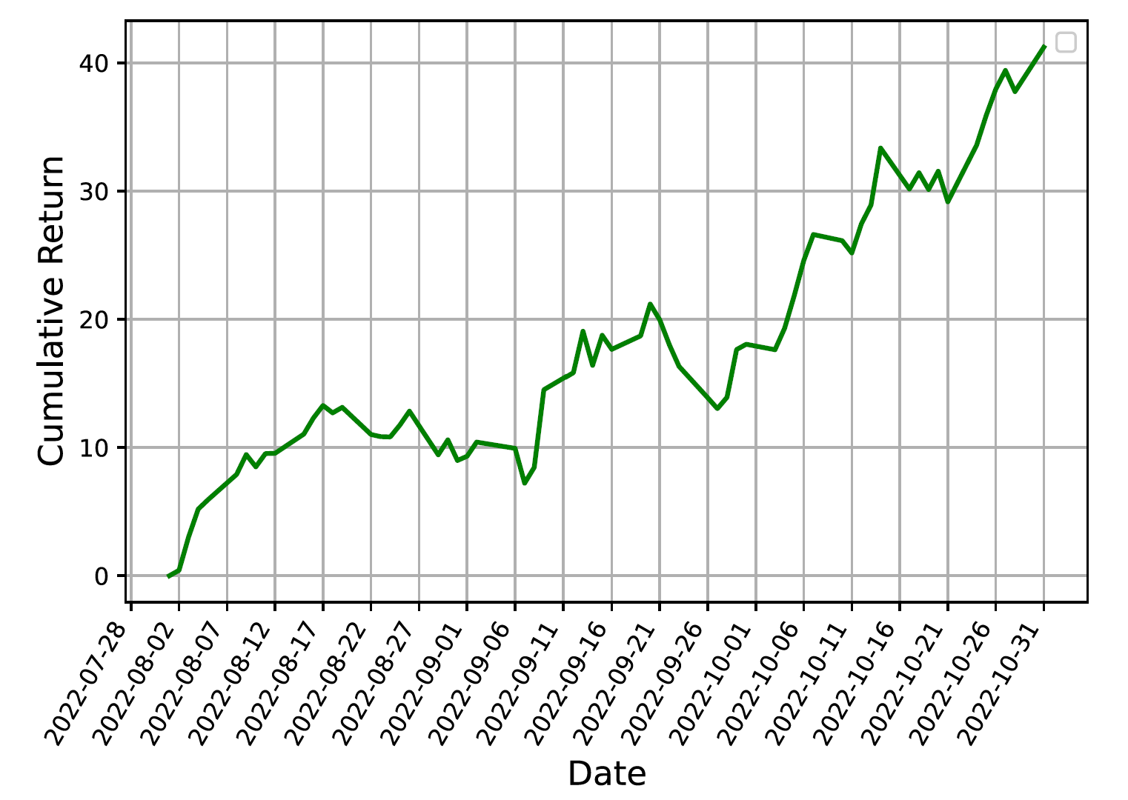
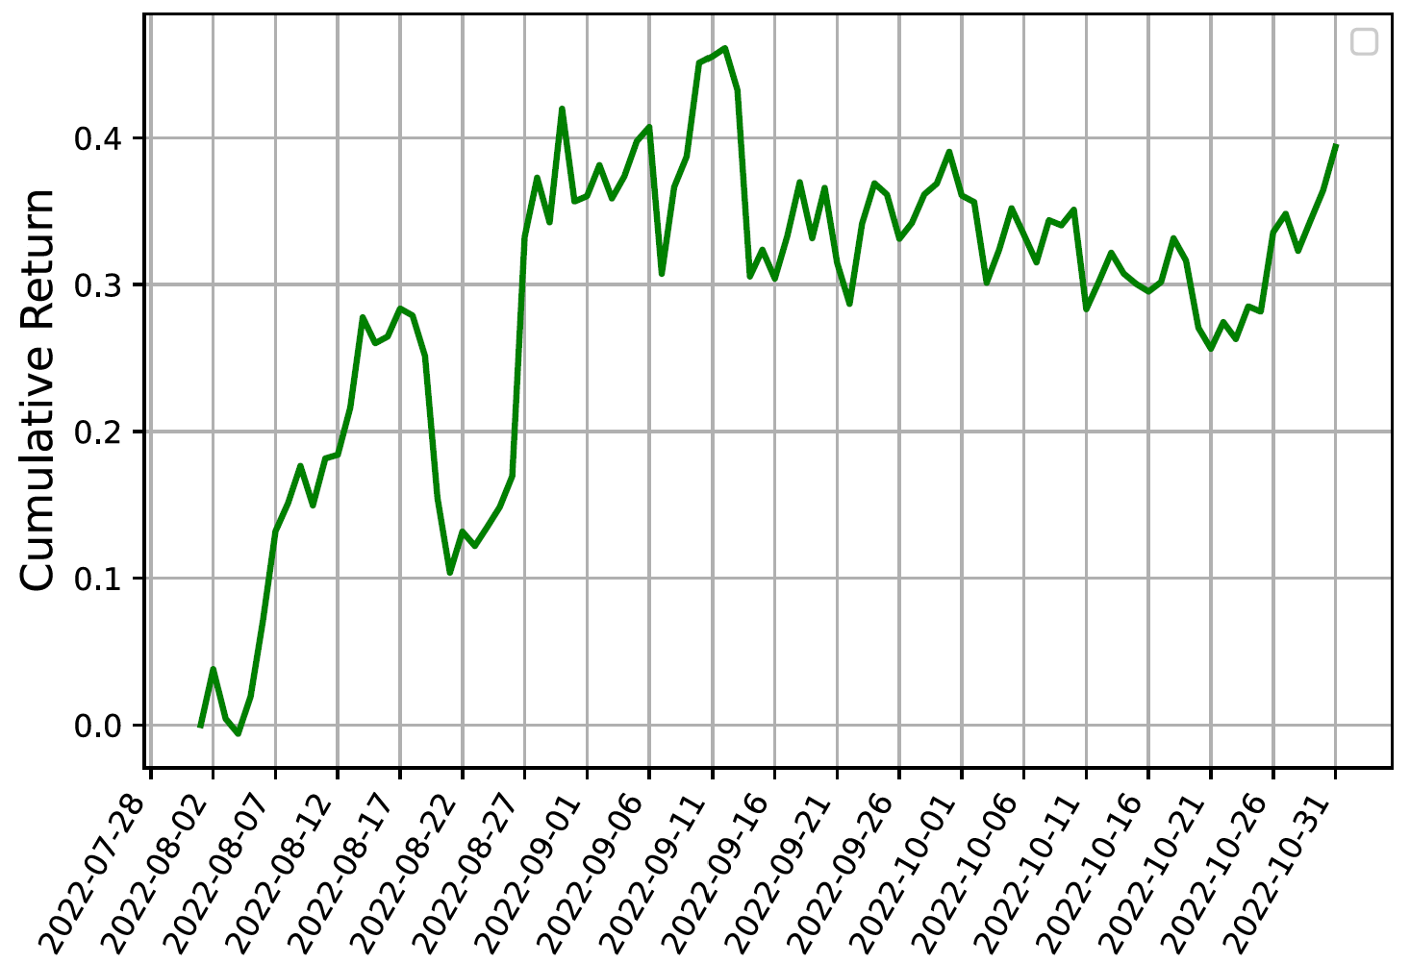
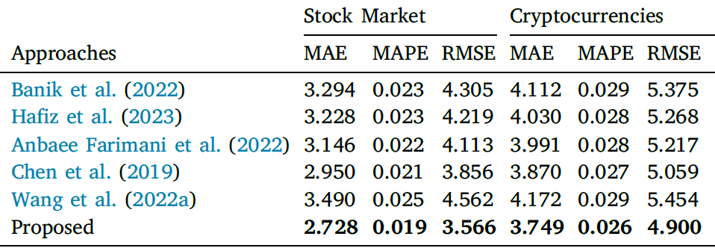
Experiment Analysis
Cumulative Percentage Economical Gain
Simulations were conducted on the NASDAQ and Cryptocurrency markets for 65-92 trading days (01/08/2022 – 31/10/2022).
Simulation step
1
Each day, the framework evaluates stocks based on their prediction scores and selects the top 50 stocks with the most predictable behavior.
2
Of the 50 stocks, 5 stocks with the highest Daily Returns were selected to be used as daily advice (investment recommendations).
3
A total of 65 daily recommendations were generated, each containing five stocks predicted to rise the following day.
Crypto Cumulative Percentage EG
In a 65-day stock market simulation, the framework achieved a 41.21% cumulative return, with 42 profitable days and 23 losing days. In the 92-day cryptocurrency simulation, it reached 59.78% accuracy (55 profitable and 37 losing days) and delivered a 39.38% cumulative return.
Tabel 15
The proposed approach outperforms baselines in both market.
Notes:
Setiap hari bursa, semua saham dievaluasi menggunakan framework yang sudah dibangun.
Framework menghasilkan evaluation score (skor evaluasi) untuk masing-masing saham.
Saham kemudian diurutkan (descending) berdasarkan evaluation score tersebut.
50 saham teratas dengan skor tertinggi dipilih karena dianggap memiliki perilaku paling bisa diprediksi pada hari itu

Slide 7
Thank You

Slide 8


